Slide 1

Text Summerization Using Transformer model
Hari Krishnan . K (192124217) Faculty Name : Dr.Poongavanam
Govardhan Reddy . A(191811424) Department of Big data Analysis

Slide 2
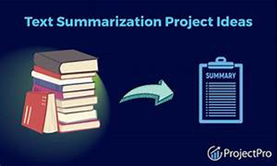
What is Text Summarization ?
Text summarization is the process of creating a short, accurate, and fluent summary of a longer text document.
There are two types of Text Summarization
Extractive Text Summarization
Abstractive Text Summarization

Slide 3
Problem Identification
As we all know that to get the content from a particular paragraph or text conversation, we are in a position to learn all the context to grasp the content.
To avoid this Text Summarization is used so that we can summarize to get the important content from the give context in a short and summarized version.

Slide 4
Model type ?
In this module we are going to use Transformer model
In the field of Natural Language Processing (NLP), "transformer" refers to a deep learning architecture introduced by Vaswani et al. in the paper "Attention is All You Need" (2017). The transformer architecture has revolutionized many NLP tasks and has become the backbone of numerous state-of-the-art models.
Transformer models are particularly well-suited for text summarization due to several reasons
Scalability
Flexible architecture

Slide 5
Other Applications
Information Overload
Document Summarization
News Summarization
Search Engine Result Summarization
Email Summarization
Legal Document Analysis

Slide 6
Problem Solution
We are using the so called transformer model to summarize the conversation that will help us to understand the overall content of the context
In this module we used samsum dataset which contains
14732 train dataset
819 test dataset
818 validation dataset

Slide 7
Thank You..

